Slide 1


Incident Management
Software Quality Assurance
Telerik Software Academy
http://academy.telerik.com

Slide 2


The Lectors
Snejina Lazarova
Project Manager
BI & Reporting Team
Dimo Mitev
QA Architect
Backend Services Team

Slide 3

Table of Contents
Incident Management – Main Concepts
Incident Reporting
Defect Lifecycle
Metrics and Incident Management
Some Golden Rules for Incident Reporting
Incident Management Tools

Slide 4


Incident Management
Main Concepts

Slide 5

What Are Incidents?
Testing often leads to observing deviations from expected results
Different names are used for that:
Incidents
Bugs
Defects
Problems
Issues
Notes:
Book: Foundations of Software Testing ISTQB Certification - 5.6 INCIDENT MANAGEMENT

Slide 6
Incident vs. Bug – A Matter of Semantics
Sometimes a distinction between incidents and bugs (defects) is made
Incident
Any situation where the system exhibits questionable behavior
Bug
An incident is referred to as a bug (defect) when the root cause is some problem in the item we're testing
Notes:
Book: Foundations of Software Testing ISTQB Certification - 5.6 INCIDENT MANAGEMENT
To be precise, we sometimes draw a distinction between incidents on the one
hand and defects or bugs on the other. An incident is any situation where the
system exhibits questionable behavior, but often we refer to an incident as a
defect only when the root cause is some problem in the item we're testing.

Slide 7
What Else Could Cause an Incident?
Other causes of incidents include:
Misconfiguration or failure of the test environment
Corrupted test data
Bad tests
Invalid expected results
Tester mistakes
According to the test policy – any type of incident can be logged for tracking
Notes:
Book: Foundations of Software Testing ISTQB Certification - 5.6 INCIDENT MANAGEMENT

Slide 8

The Earlier – The Cheaper
Incident logging or defect reporting are not necessarily happening during testing
Incidents can be logged, reported, tracked, and managed during development and reviews

Slide 9

What Do We Report Defects Against?
Defects can be reported against:
The code or the system itself
Requirements
Design specifications
User and operator guides and tests

Slide 10
Glossary
Defect (bug)
A flaw in a component or system that can cause the component or system to fail
Error
A human action that produces an incorrect result
Failure
Deviation of the component or system from its expected delivery, service, or result
Notes:
Book: Advanced Software Testing - Vol. 1 -chapter 3.9. Risk-Based Testing - Chapter 7. Incident Management

Slide 11
Glossary (2)
Incident
Any event occurring that requires investigation
Occurs anytime the actual results of a test and the expected results of that test differ
Incident logging
Recording the details of any incident that occurred (e.g., during testing)
Root cause analysis
An analysis technique aimed at identifying the root causes of defects
Notes:
Book: Advanced Software Testing - Vol. 1 -chapter 3.9. Risk-Based Testing - Chapter 7. Incident Management

Slide 12

Incident Reporting

Slide 13

Managing Defects
Defects found can reach count that is hard to manage
A process for handling defects from discovery to final resolution is needed
Should include reporting, classifying, assigning and managing defects

Slide 14

Central Database
A central database for each project should be established
All incidents and failures discovered during testing are registered and administered
Developers, QAs and stakeholders have access

Slide 15
What Goes in an Incident Report?
An incident report usually includes:
Summary
Steps to reproduce
Including inputs given and outputs observed
Isolation steps tried
Impact of the problem
Expected and actual behavior
Notes:
Book: Foundations of Software Testing ISTQB Certification - 5.6 INCIDENT MANAGEMENT

Slide 16

What Goes in an Incident Report? (2)
An incident report usually includes:
Date and time of the failure
Phase of the project
Test case that produced the incident
Name of the tester
Test environment
Notes:
Book: Foundations of Software Testing ISTQB Certification - 5.6 INCIDENT MANAGEMENT

Slide 17

What Goes in an Incident Report? (3)
References to external sources
Specification documents
Various work items
Attachments
Videos and screenshots
Any additional information about the configuration

Slide 18

What Goes in an Incident Report? (4)
Root cause of the defect
Usually set by the programmer, when fixing the defect
Status and history information
Comments
Final conclusions and recommendations

Slide 19
What Goes in an Incident Report? (5)
Severity and priority of the defect
Sometimes classified by testers
Sometimes a bug triage committee is responsible for that
Determines also the risks, costs, opportunities and benefits associated with fixing or not fixing the defect

Slide 20
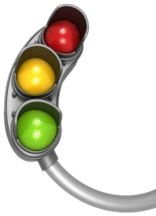
Defect Severity
What is a defect "severity"?
The degree of impact on the operation of the system
Possible severity classification could be:
1 – Blocking
2 – Critical
3 – High
4 – Medium
5 – Low

Slide 21
Defect Severity Levels
Blocking
Stops the user from using the feature as it is meant to be used
No reasonable workaround
Critical
Data corruption
Easily and repeatably throws an exception
No reasonable workaround
Feature does not work as expected
Notes:
Note: This is a sample classification for bug severity. Different teams and organizations may use different classifications.

Slide 22
Defect Severity Levels (2)
High
Throws an exception when not following the happy path
Confusing UI
Has a reasonable workaround
Medium
Feature works off the happy path with minor issues
Small UI issues
One or more reasonable workarounds

Slide 23
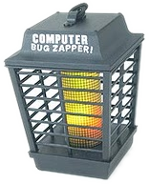
Defect Severity Levels (3)
Low
Cosmetic issues
Many workarounds
Low visibility to users

Slide 24

Defect Priority
What is a defect "priority"?
Indicates how quickly the particular problem should be corrected
Possible priority classification could be:
1 – Immediate
2 – Next Release
3 – On Occasion
4 – Open (not planned for now)

Slide 25
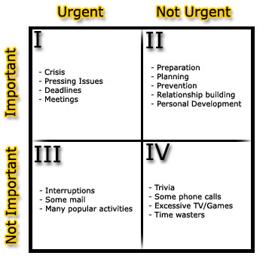
Defect Priority(2)
Covey's Quadrants
Defects are categorized by four quadrants:
QI - Important and Urgent
QII - Important but Not Urgent
QIII - Not Important but Urgent
QIV - Not Important and Not Urgent

Slide 26

Defect Priority(3)
The ABC Method
A = vital
B = important
C = nice
Then these categories are subdivided into A1, A2, A3, ..., B1, B2, ... and so forth
The Payoff versus Time Method
Weight each defect by the payoff expected from it versus the time it takes to be done

Slide 27

Defect Priority(4)
Paired Comparison
Uses a simple scoring system for comparing activities
1 = slightly prefer 2 = moderately prefer 3 = greatly prefer
Option | A: | B: | C: | D:
A: |  | A,1 | C,2 | A,1
B: |  |  | C,2 | D,2
C: |  |  |  | C,2
D:
A=1+1=2
B=0
C=2+2+2=6
D=2
The option with highest result has the highest priority

Slide 28

Defect Lifecycle

Slide 29
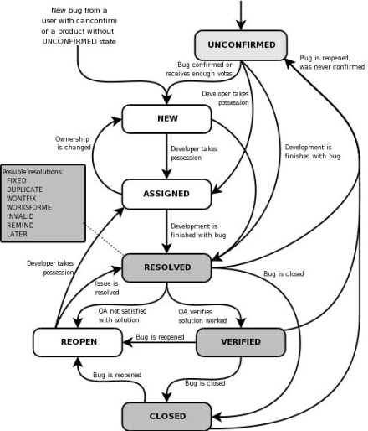
Defect Lifecycle
Defect lifecycles are usually shown as state transition diagrams
Different defect-tracking systems may use different defect lifecycles

Slide 30
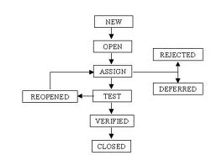
Defect Lifecycle Graph
Simple defect lifecycle graph
Notes:
Graph source: Foundations of Software Testing ISTQB Certification - 5.6 INCIDENT MANAGEMENT
See another bug lifecycle state transition graph here: http://www.softwaretestinghelp.com/wp-content/qa/uploads/2007/09/bug-life-cycle1.jpg

Slide 31
Defect Lifecycle States
New
The bug is posted for the first time
The bug is not yet approved
Open
The test lead approves that the bug is genuine
Changes the state as “OPEN”.
Assign
The bug is assigned to corresponding developer or developer team
Notes:
http://www.exforsys.com/tutorials/testing/bug-life-cycle-guidelines.html

Slide 32
Defect Lifecycle States (2)
Test
The bug has been fixed and is released to testing team
Rejected
If the developer feels that the bug is not genuine, he rejects the bug
Duplicate
The bug is repeated twice or the two bugs mention the same concept of the bug

Slide 33
Defect Lifecycle States (3)
Deferred
The bug is expected to be fixed in next releases
Reasons for changing the bug to this status may have many factors:
Bug may be low
Lack of time for the release
the bug may not have major effect on the software

Slide 34

Defect Lifecycle States (4)
Verified
Once the bug is fixed and the status is changed to “TEST”, the tester tests the bug
If the bug is not present in the software, he approves that the bug is fixed

Slide 35

Defect Lifecycle States (5)
Reopened
The bug still exists even after the bug is fixed by the developer
The bug traverses the life cycle once again
Closed
The bug is fixed, tested and approved

Slide 36
Metrics and Incident Management
Notes:
ISTQB - Advanced Level Syllabus [2007]:
Defect information needs to include enough information to assist in test progress monitoring, defect
density analysis, found vs. fixed metrics and convergence metrics (open vs. closed). In addition,
defect information needs to support process improvement initiatives by tracking phase containment
information, root cause analysis and identifying defect trends to be used as input to strategic risk
mitigation adjustments.

Slide 37

Defect Management Metrics
Various metrics can be used for defect management during a project
Helps managing defect trends
Helps determining readiness for release

Slide 38
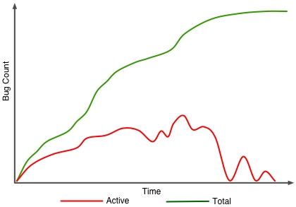
Defect Management Metrics (2)
Total number of bugs
Number of open (active) bugs/tasks
Number of resolved bugs/tasks
Notes:
http://www.teknologika.com/blog/software-development-metrics-defect-tracking/

Slide 39

Defect Management Metrics (3)
Bugs per category
Bug cluster analysis
Defect density analysis
Number of defects discovered on a time unit
E.g., week, testing iteration, etc.

Slide 40

Defect Management Metrics (4)
Mean-time to fix a defect
The time between reporting and fixing/closing the bug
Time estimates versus actual time spent comparison
Gives confidence in the estimates given by the team

Slide 41
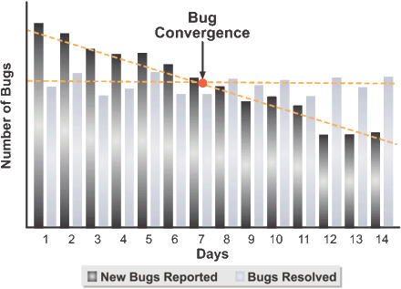
Bug Convergence
Bug Convergence
Also called open/closed charts
The point at which the rate of fixed bugs exceeds the rate of found bugs
A visible indication that the team is making progress against the active bug count
A sign that the project end is within reach

Slide 42
Defect Detection Percentage
Gives a measure of testing effectiveness
Some defects are found prior to release while others - after deployment of the system
The defect detection percentage (DDP) compares field defects with test defects, also called escaped defects
defects (testers)
DDP
=
defects (testers) + defects (field)

Slide 43

Some Golden Rules for Incident Reporting

Slide 44
Golden Rules for Bug Reporting
Watch your tests
Run your tests with care and attention
You never know when you're going to find a problem
Reporting intermittent or sporadic symptoms
Some defects cannot be reproduced always
Report how many times you tried to reproduce it and how many times it did in fact occur

Slide 45
Golden Rules for Bug Reporting (2)
Isolate the defect
Make carefully chosen changes to the steps used to reproduce it
Move from boundary values to more generalized conditions
Provide information on the defect's impact
Makes setting priority and severity easier and more accurate

Slide 46
Golden Rules for Bug Reporting (3)
Mind your language
Choose the right words in your report
Be clear and unambiguous, neutral, fact-focused and impartial
Be concise – avoid useless detailes
Make reviews of bug reports
Make an experienced tester take a look a your report

Slide 47
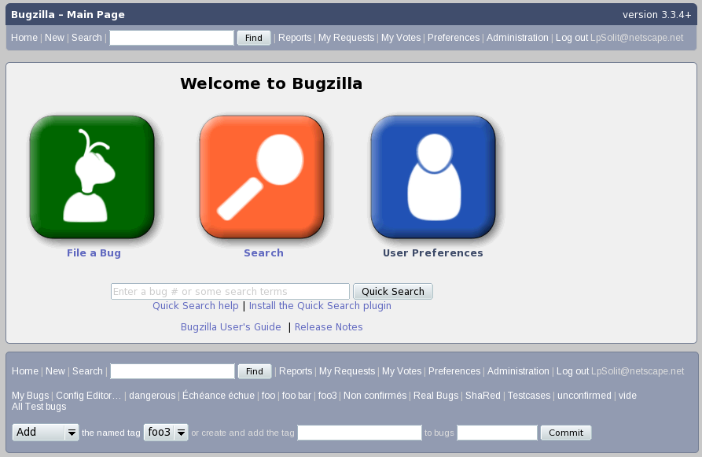
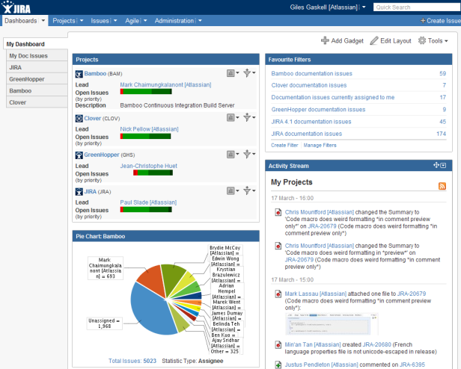
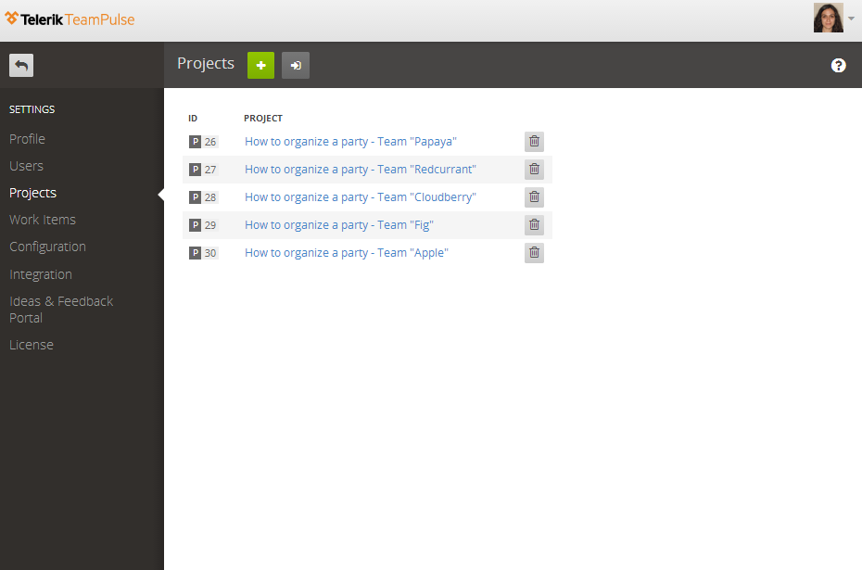
Incident Management Tools

Slide 48
Telerik TeamPulse
TeamPulse is an agile project management solution
Requirements Management
Bug Management
Planning and Scheduling
Time Tracking
Ideas and Feedback Management
Filtering
Reporting

Slide 49
TeamPulse Demo
Login
Setup a new Project
Enter a new work item (Story/Task, Bug, Issue, Risk, Feedback)
Manage work items
Resolve and Close
Search, Reports, Email notifications, etc.

Slide 50

JIRA
What is JIRA?
A proprietary issue tracking product,
Developed by Atlassian
Used for
Bug tracking
Issue tracking
Project management
http://www.atlassian.com/software/jira/

Slide 51
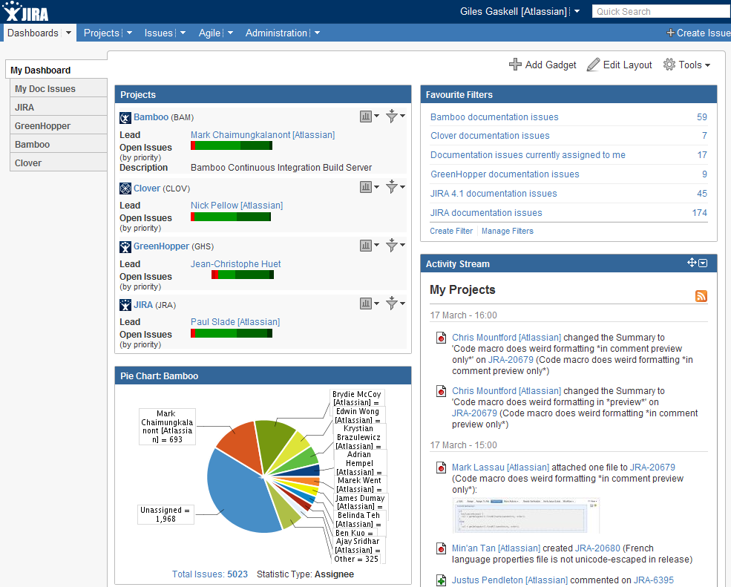
JIRA - Demo
Login
Manage Dashboard
Enter a new Project
Enter a new Component
Enter a Defect
Manage Defect
Resolve and Close
Search, Reports, Email, etc.

Slide 52

Bugzilla
What is Bugzilla?
Web-based bugtracker
Originally developed and used by the Mozilla project
http://www.bugzilla.org/

Slide 53
Bugzilla
Demo

Slide 54
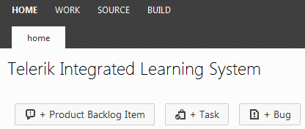
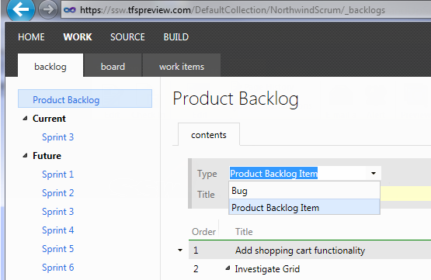
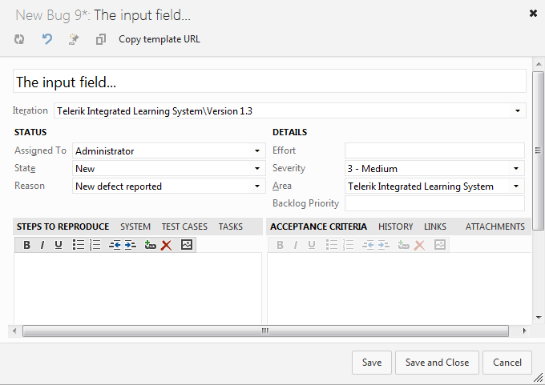
Team Foundation Server
What is TFS?
Microsoft product offering
Source control
Data collection
Reporting
Project tracking

Slide 55
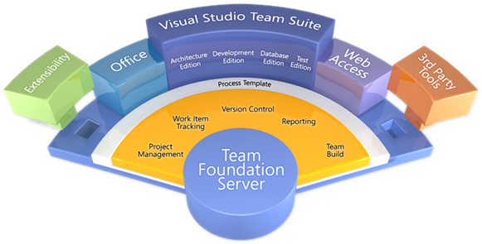
TFS
Demo

Slide 56


Other Bug-tracking Tools
Some other bug-tracking tools:
MantisBT
TRAC
GNATS

Slide 57
Exercises
Go to http://testws.galileo.com/GWSSample/Pages/MainPage/MainFrame.aspx. Have a look at the system and prepare some test cases for the reservation page. Execute them and if you find any bugs prepare bug reports in your Team Pulse project.

Slide 58
Incident Management
?
?
?
?
?
Questions?
?
?
?
?
?
?

Slide 59




Free Trainings @ Telerik Academy
C# Programming @ Telerik Academy
csharpfundamentals.telerik.com
Telerik Software Academy
academy.telerik.com
Telerik Academy @ Facebook
facebook.com/TelerikAcademy
Telerik Software Academy Forums
forums.academy.telerik.com

